Slide 1
Machine Learning Accident Analysis Report
A Comprehensive Data-Driven Study
Presented by
Francis gallo sahayaraj
Manasa manvitha mukka

Slide 2
Introduction
Objective: To analyze traffic accident data to predict mortality.
Overview of Analysis Steps: Cleaning data, handling imbalance with SMOTE, using multiple machine learning models, and tuning using GridSearchCV.

Slide 3
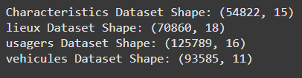
Datasets Overview
Characteristics Dataset: Provides accident details.
Locations Dataset: Road and environmental details.
Users Dataset: Information about users involved, like age, gender, and injury type.
Vehicles Dataset: Details of vehicles involved.

Slide 4

MERGING THE DATASETS
Merging Process: Combined all four datasets based on a unique accident identifier (NUM_ACC)
Resulting Dataset: 309,341 records with combined accident, vehicle, user, and location details.

Slide 5
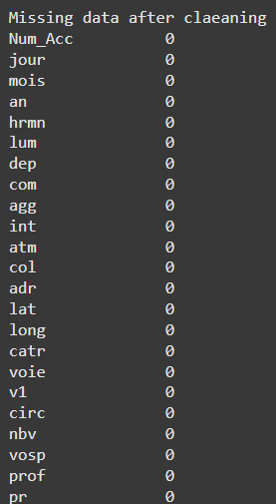
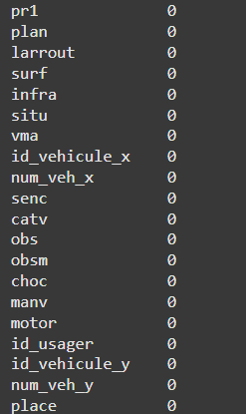
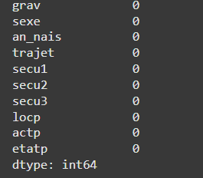
Data Cleaning and Handling Missing Values
Missing Values Handling:
Columns with More Than 50% Missing Data: Removed these columns.
Filling Remaining Missing Values: Numerical columns filled with the median, categorical columns filled with mode.

Slide 6
Creating the Mortality Variable
Mortality Feature Creation: Created a binary variable called mortality
where
1 indicates a fatality
0 indicates no fatality

Slide 7
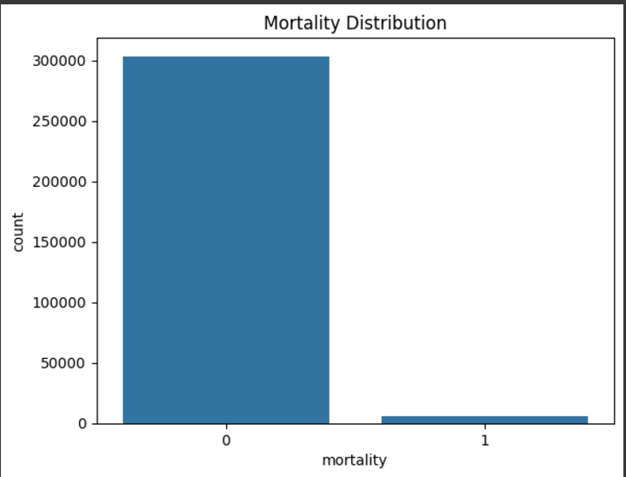
Distribution Analysis:
Mortality Imbalance: Significantly more non-fatal cases compared to fatal cases.

Slide 8
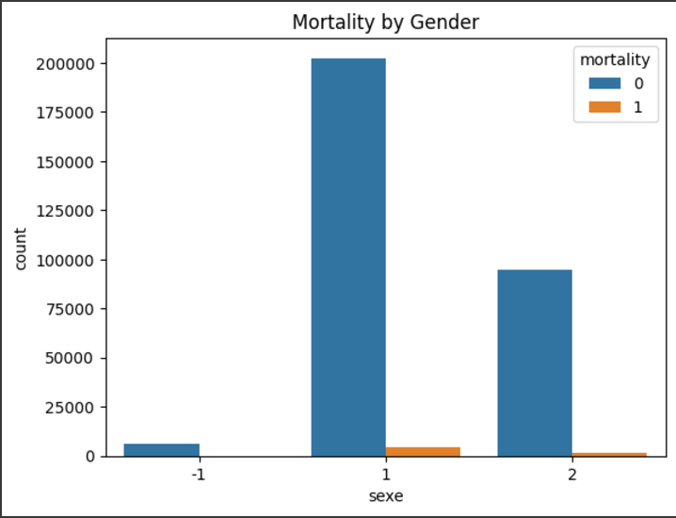
Exploratory Data Analysis (EDA)
Exploration of Accident Trends:
Mortality by Gender: Patterns in accident fatality based on gender.

Slide 9
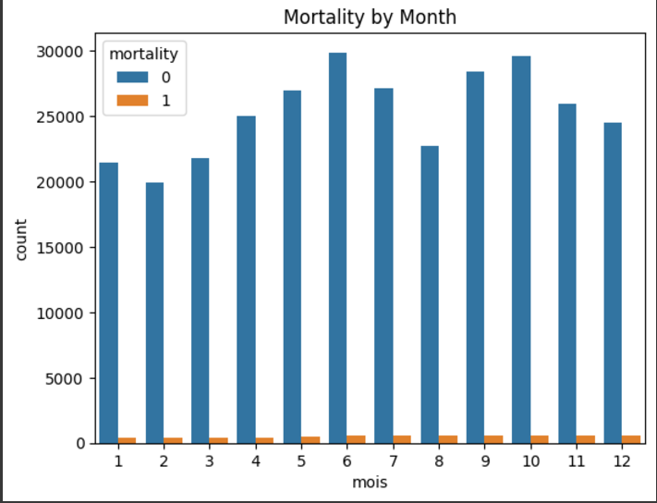
Accidents by Month: Trends in accident frequency across month.

Slide 10
Machine Learning Models Overview
Logistic Regression: A simple linear model for binary classification.
Random Forest: An ensemble model combining multiple decision trees for better predictive power.
Neural Network: A model that can capture complex patterns through multiple interconnected layers.

Slide 11
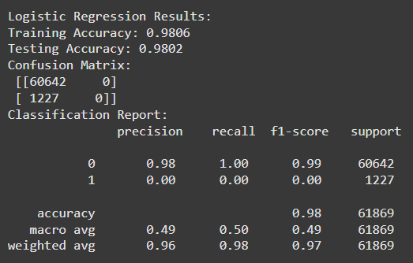
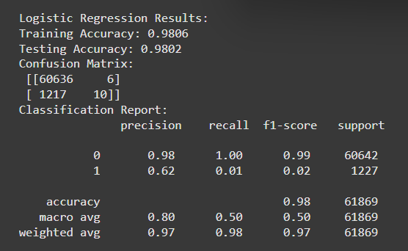
Original Data vs Normalized Data Performance
Models Evaluated: Logistic Regression, Random Forest, Neural Network.
Logistic Regression on Original vs Normalized Data:
Original Data
Training Accuracy: 98.06%
Testing Accuracy: 98.02%
Normalized Data:
Slight improvement in precision and recall

Slide 12
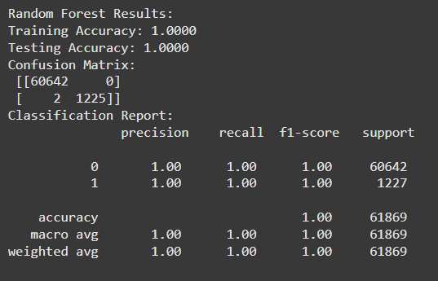
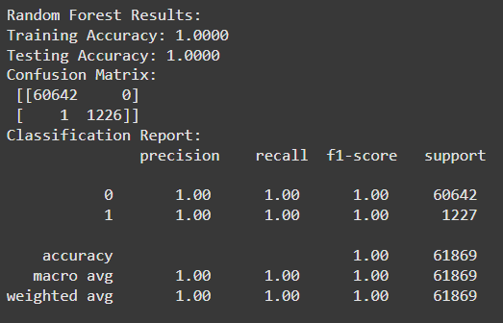
Random Forest on Original vs Normalized Data
vs

Slide 13
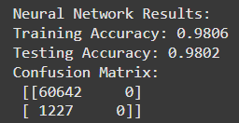
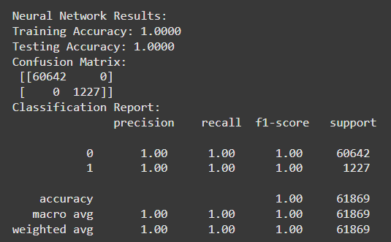
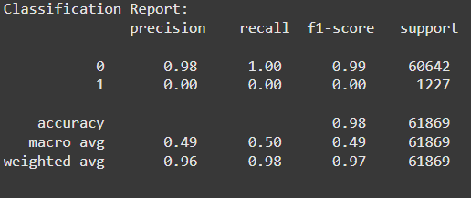
Neural network on Original vs Normalized Data
vs

Slide 14
Handling Class Imbalance with SMOTE
Why Use SMOTE?: The dataset was highly imbalanced with significantly fewer fatal cases compared to non-fatal ones.
SMOTE Outcome: Balanced dataset with equal representation of fatalities and non-fatalities, allowing models to better learn minority class features.

Slide 15
Applying SMOTE to All Models
Purpose of SMOTE: To balance out the dataset by generating synthetic samples for the minority class.
Outcome: Created a more balanced representation, allowing models to better generalize for fatalities.

Slide 16
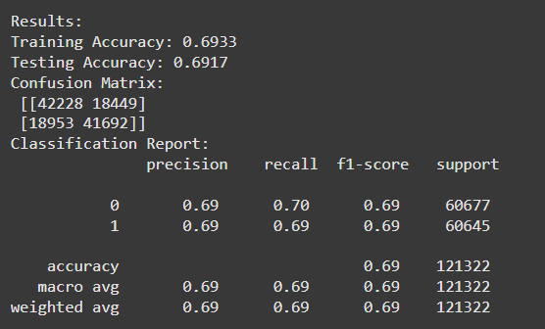
Logistic Regression with SMOTE
Training accuracy : 69.33%
Testing accuracy : 69.17%
Results: significantly improved recall and F1 score for fatalities (mortality = 1)

Slide 17
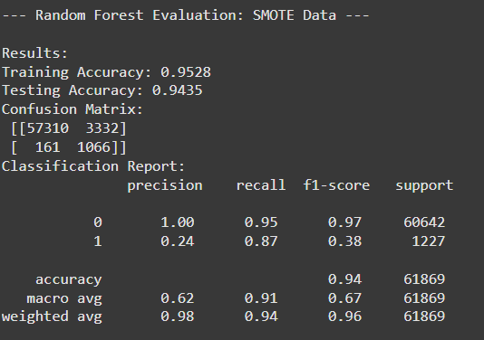
Random Forest Performance with SMOTE
Random Forest with SMOTE
Training accuracy : 93%
Testing accuracy : 92%

Slide 18
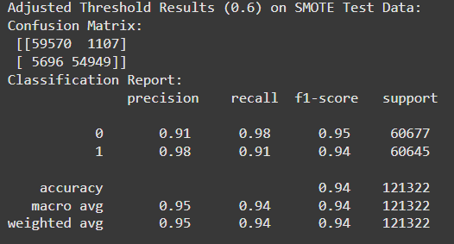
Adjustment in threshold

Slide 19
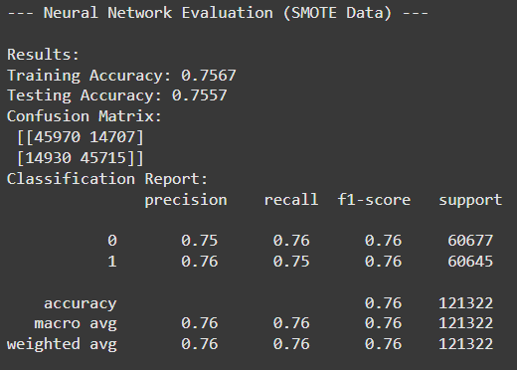
Neural Network Performance with SMOTE
Neural Network After SMOTE
Training accuracy : 75.67%
Testing accuracy : 75.57%
Results: Improved model performance, especially recall for fatalities.

Slide 20
Cross-Validation Introduction
Evaluates the stability and consistency of the models by using multiple data splits.
Purpose: Ensure that the model's performance is consistent and not reliant on a specific train-test split.

Slide 21
Cross-Validation Results
Logistic Regression with Cross-Validation (Mean F1 macro score: 69.31%)
Random Forest with Cross validation (Mean F1 macro score : 95.02%)
Neural Network with Cross validation (Mean F1 macro score: 74.20%)

Slide 22
Why Random Forest Performed Best
High Precision and Recall: Balanced accuracy across both classes.
Hyperparameter Tuning: Fine-tuning through GridSearchCV yielded excellent performance metrics.
Result Consistency: Cross-validation confirmed Random Forest's robustness and minimal overfitting.

Slide 23
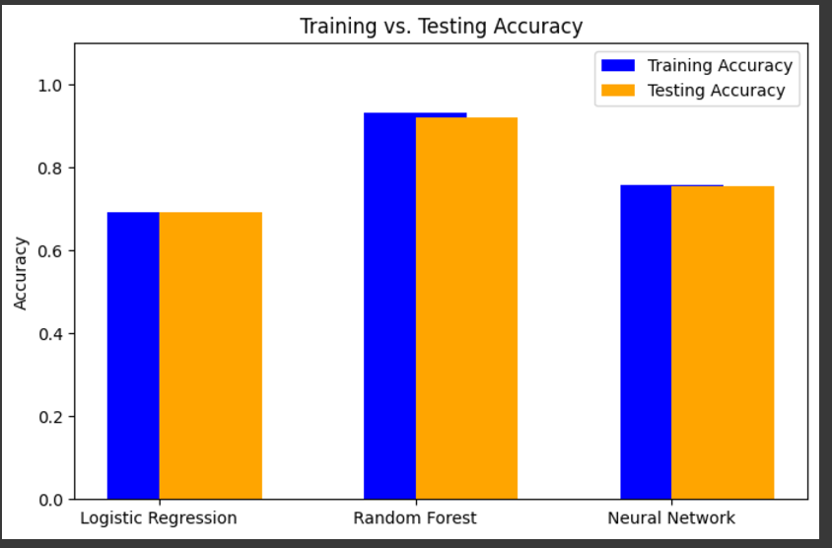

Slide 24
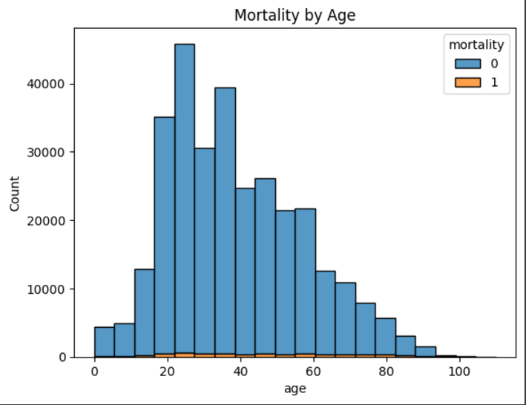
Exploratory Visuals:
Mortality by Age:

Slide 25
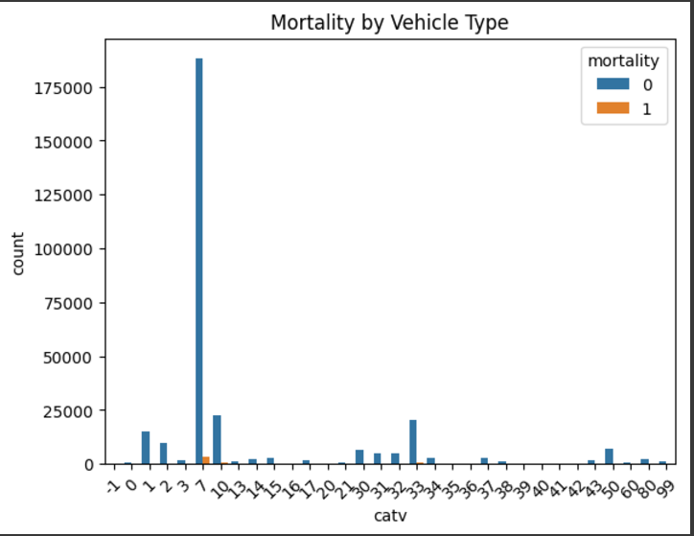
Vehicle Type and Mortality:

Slide 26
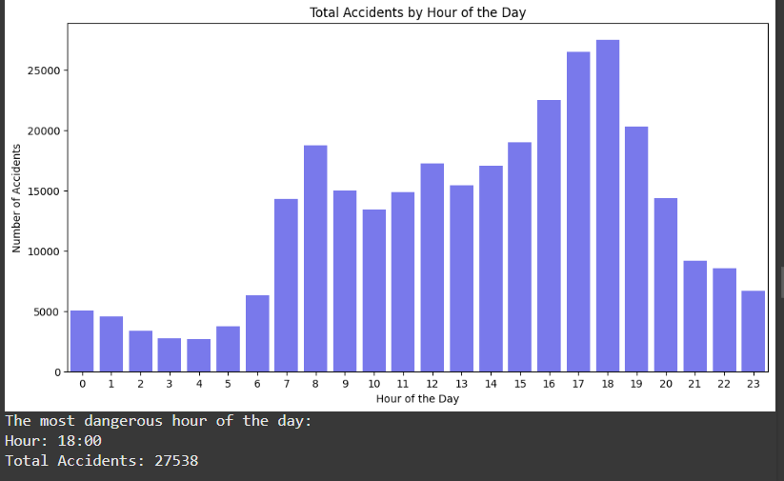
Accident Time:

Slide 27
Conclusion
Best Model: Random Forest with cross validation values
Impact of smote: balanced the dataset, leading to better model performance

